Slide 1

Blast Chillers and Shock Freezers
An overview of blast chiller offerings, including self-contained and modular units, with a look at the latest next-generation updates.

Slide 2


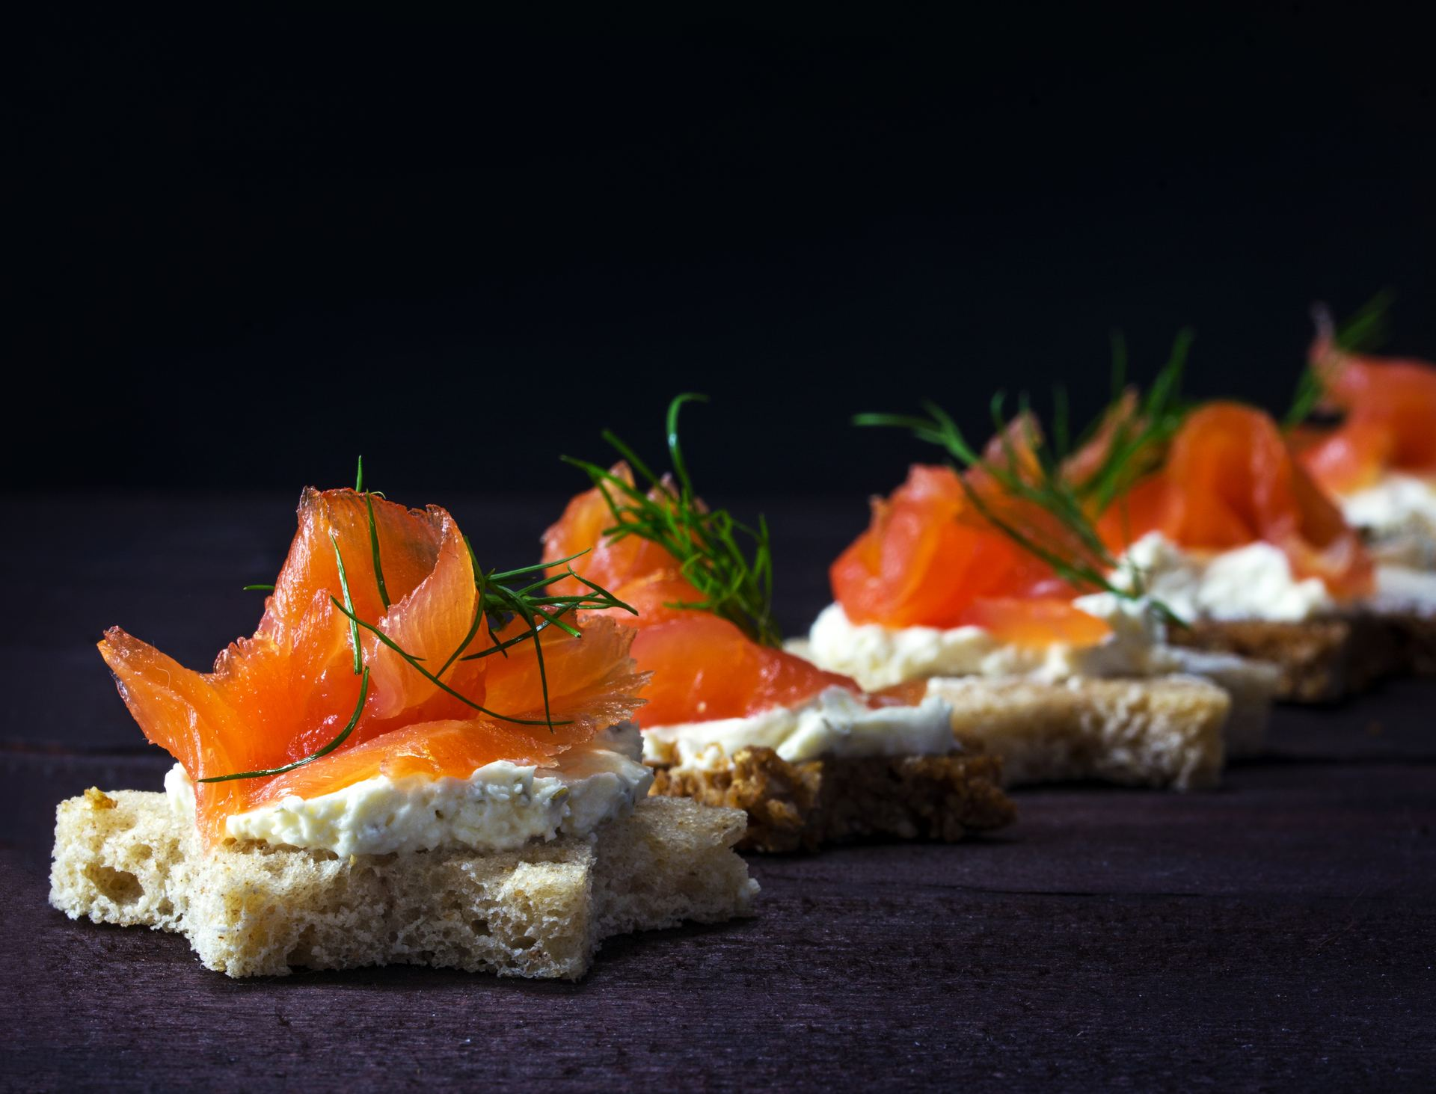
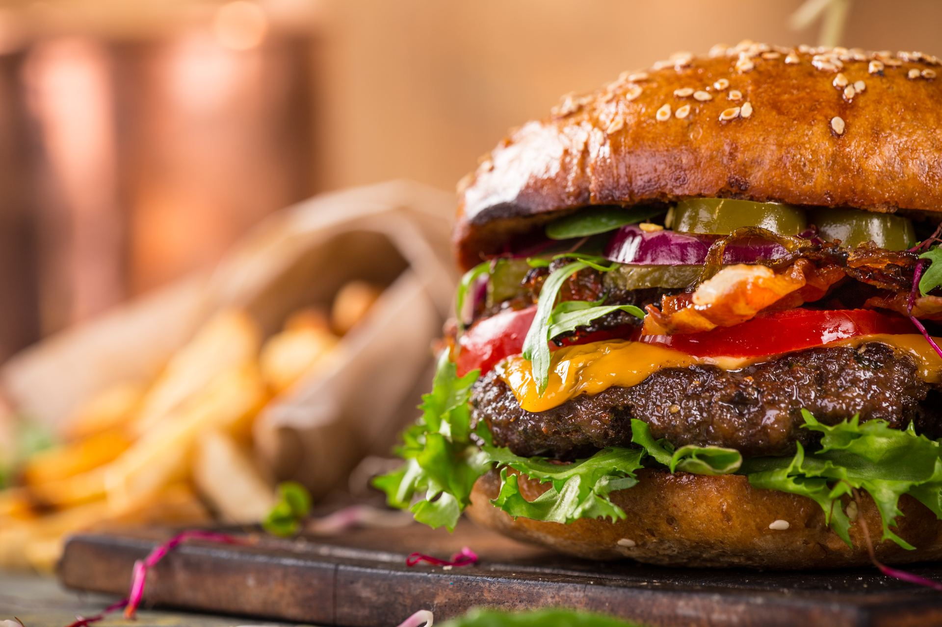
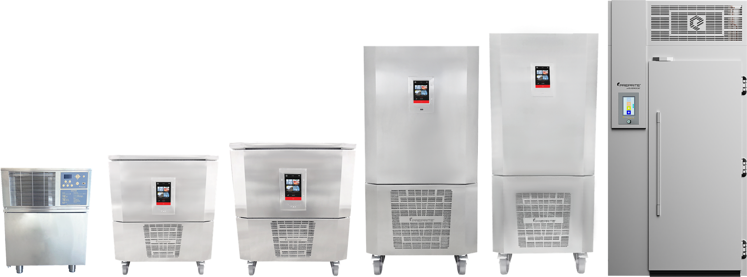
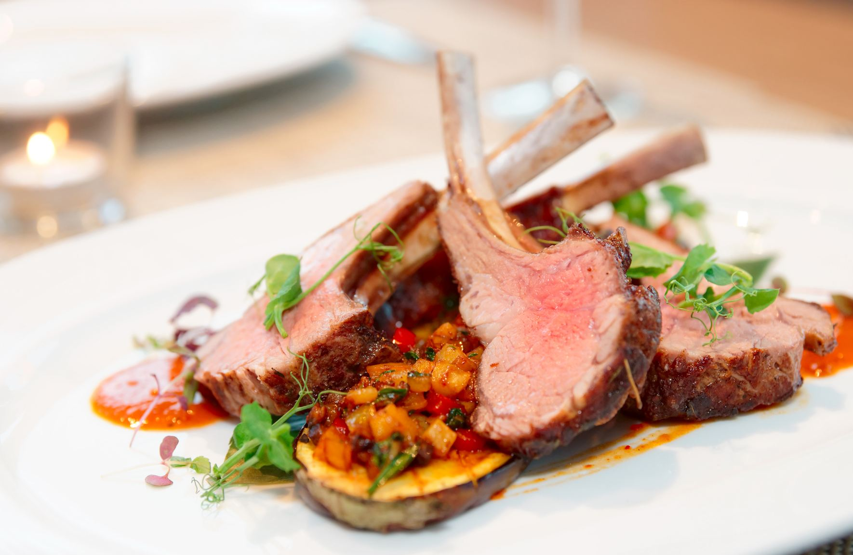
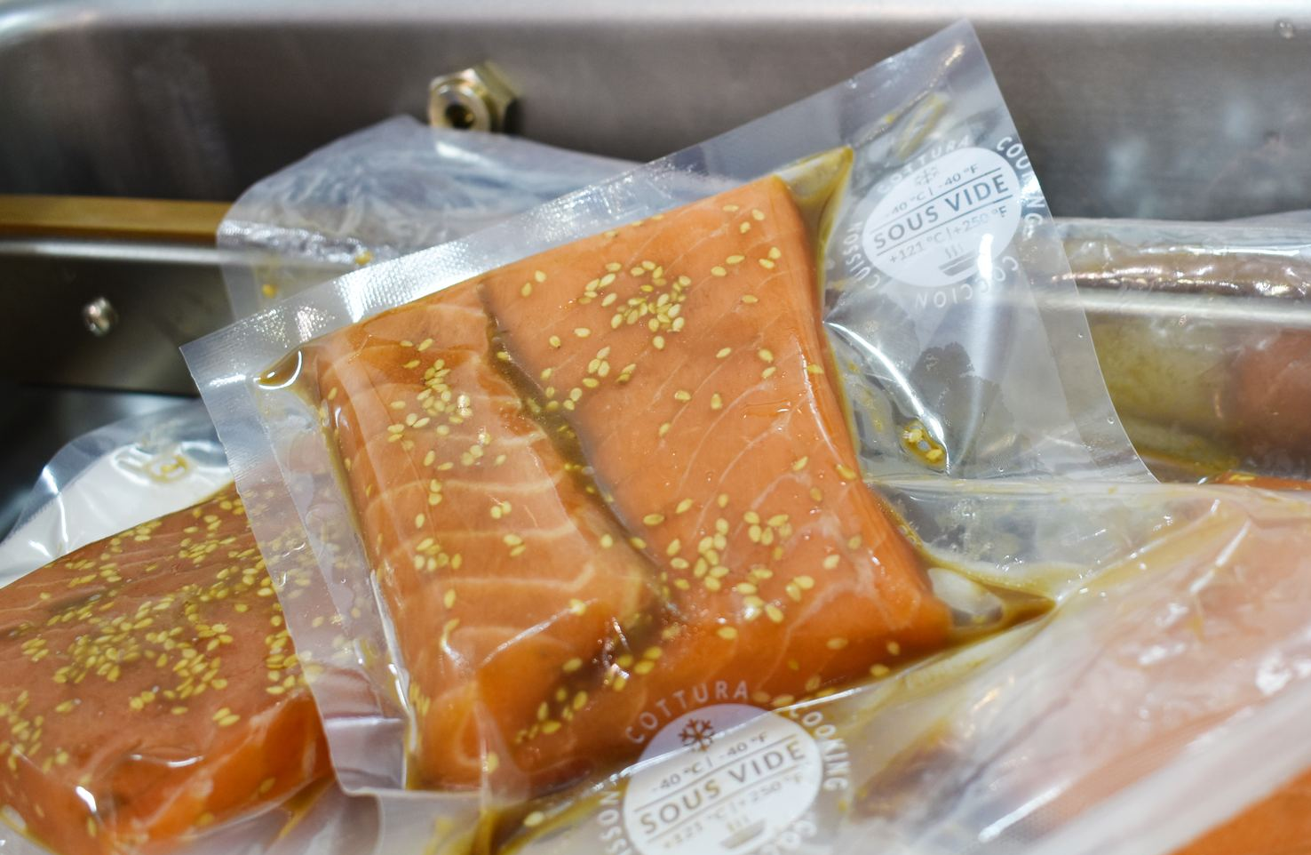

Blast Chillers/Shock Freezers
Pastry
Chocolate
Specify for food safety, leverage for productivity!
Models range from modular walk-ins to countertop, undercounter, and standalone models to meet desired capacities
Ambient chill method for rapid temperature pull down
Catering
Foodservice
Gastronomy
Cook-Chill
“The blast chiller was a lifesaver during the last few months! Without it, we would have lost so much product and not made it through.” – Lisa Mickey, Lead Chocolatier

Slide 3

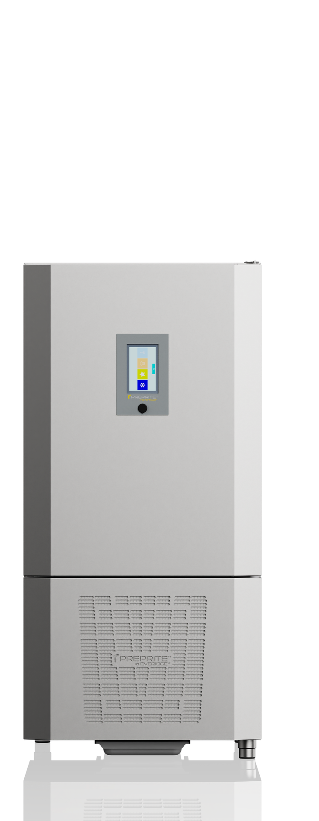
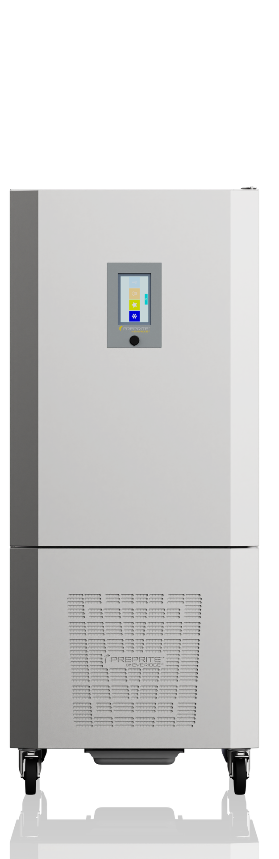
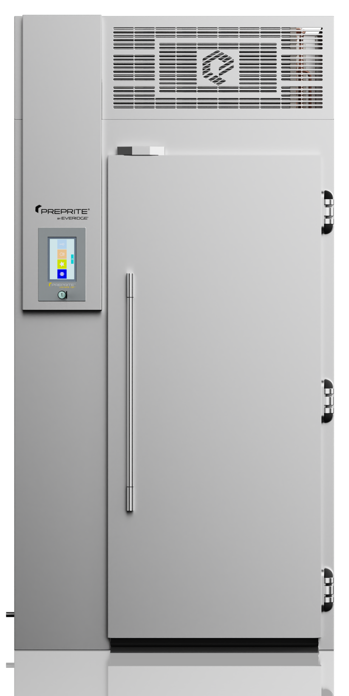
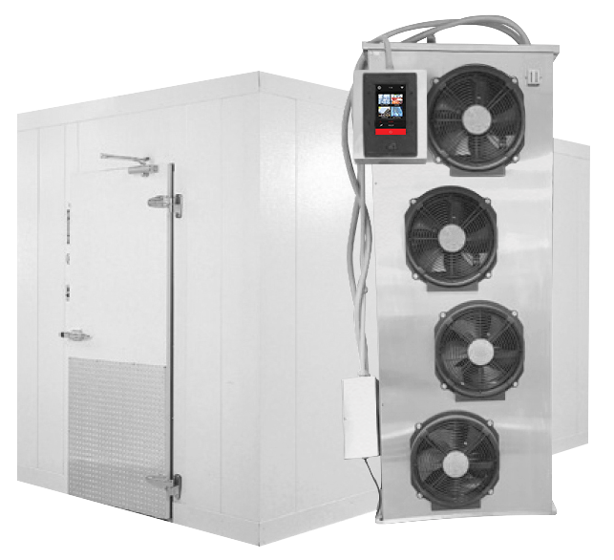
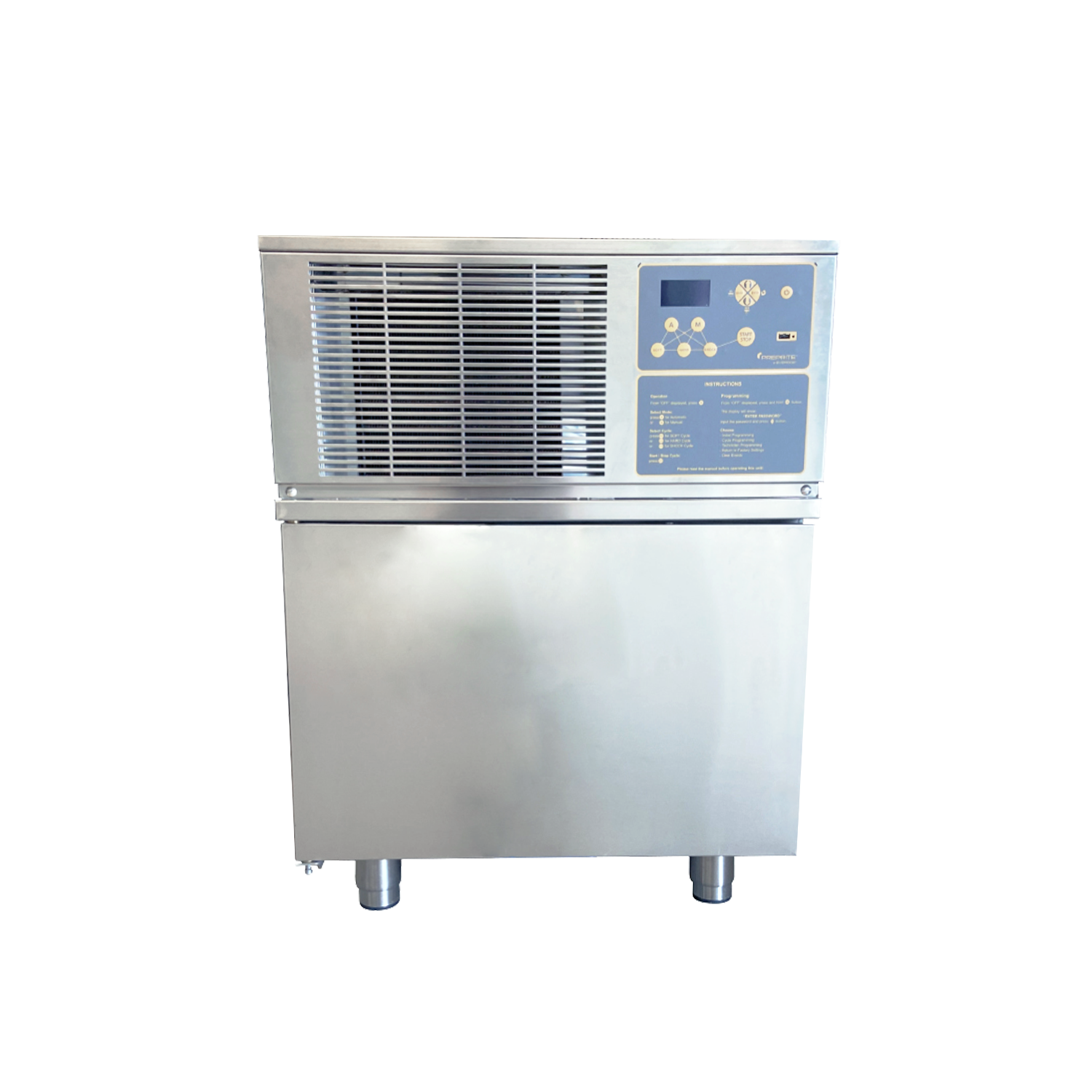
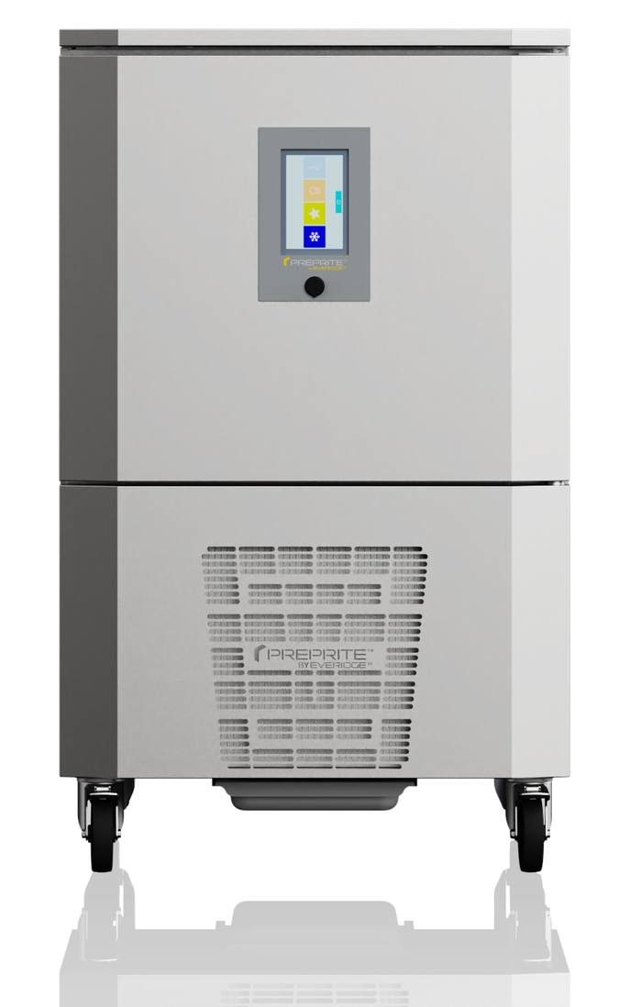
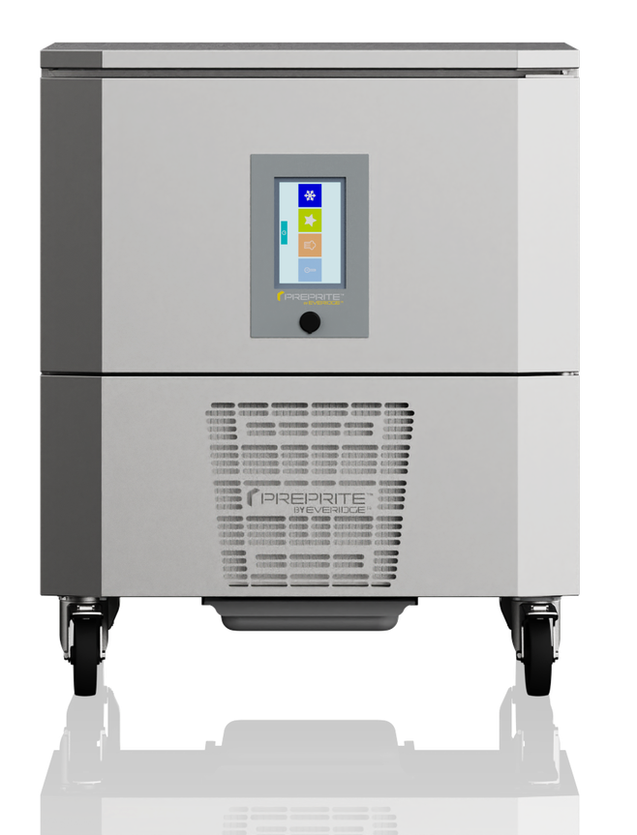
PBF Self-Contained & Modular Offerings
An intuitive and complete family of blast chillers and shock freezers from the GREEN PBF4.0 R290 refrigerant undercounter unit to our fully customized modular units capable of chilling up to 1200-lbs in just 90 minutes!
R290
4.0
5.0
7.0
12.0
15.0
20.1
250 | 450 | 850 | 1200

Slide 4

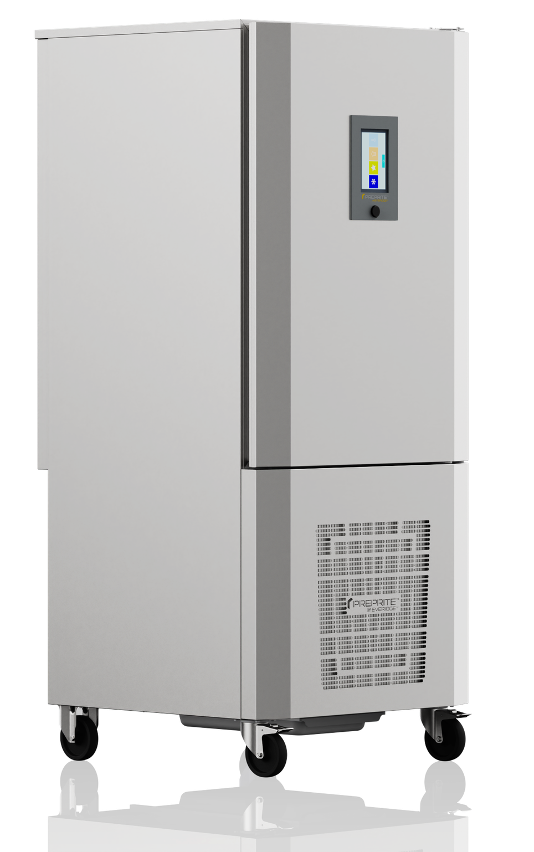

More Powerful Than the Rest
Most Blast Chillers
Can chill food down from 160°F to 37°F in 90 minutes
Requires cooling hot food down to 160°F before blast chilling
Additional wire racks for hotel pan accommodation
Our PBF 3.0, 5.0, 7.0, 12.0, 15.0, & 20.1 Blast Chillers
Can chill food down from 194F to 37F in 90 minutes
One less step for operators that also saves precious time
Universal pan slides for sheet pans or hotel pans

Slide 5
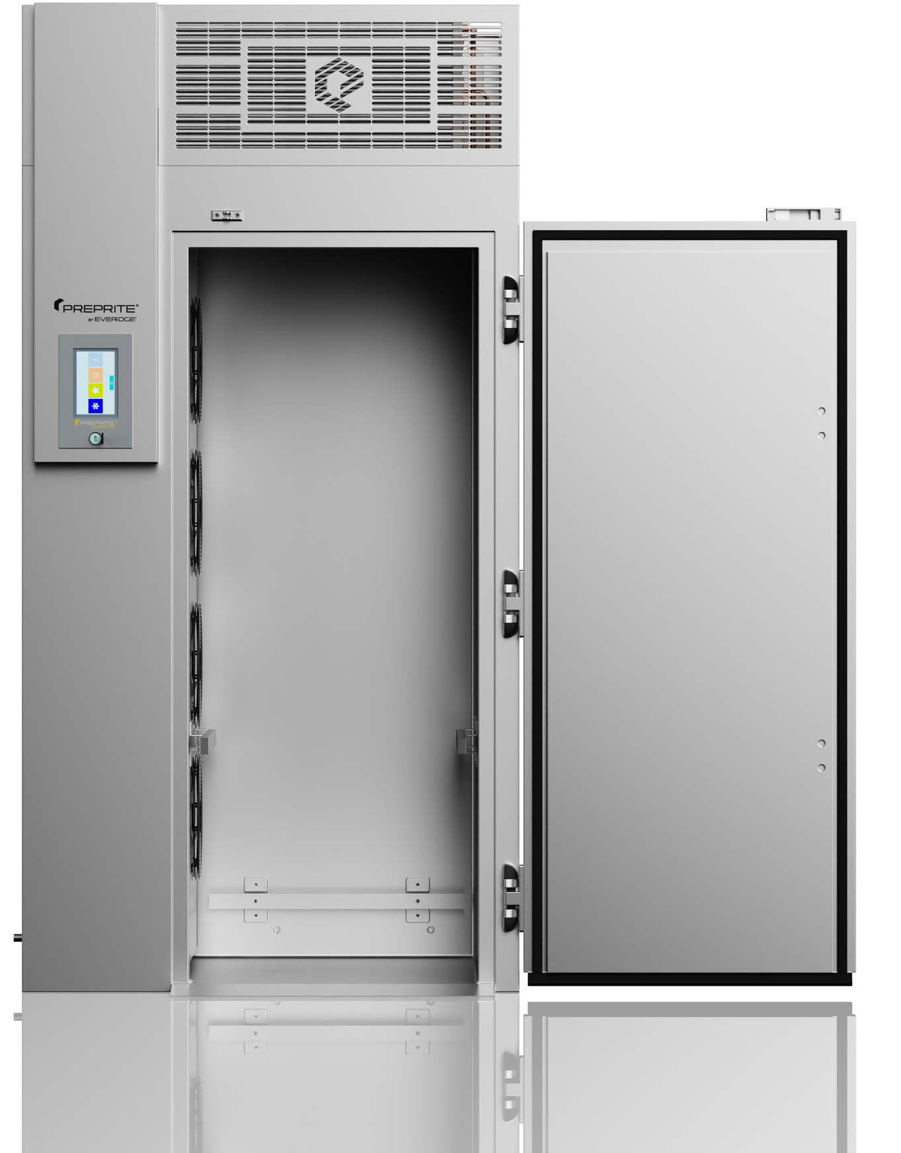
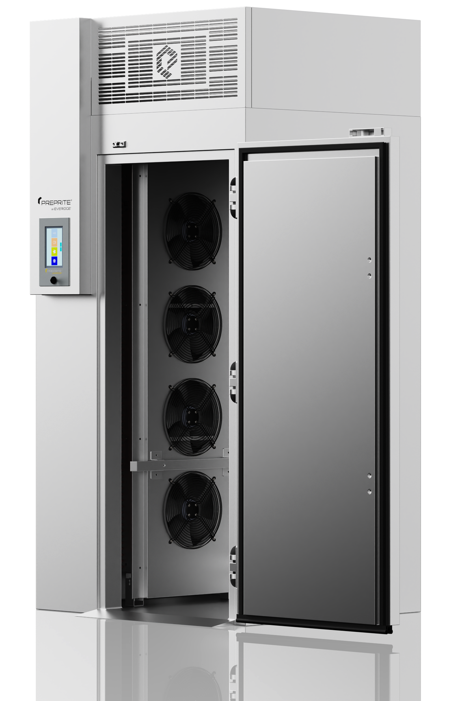
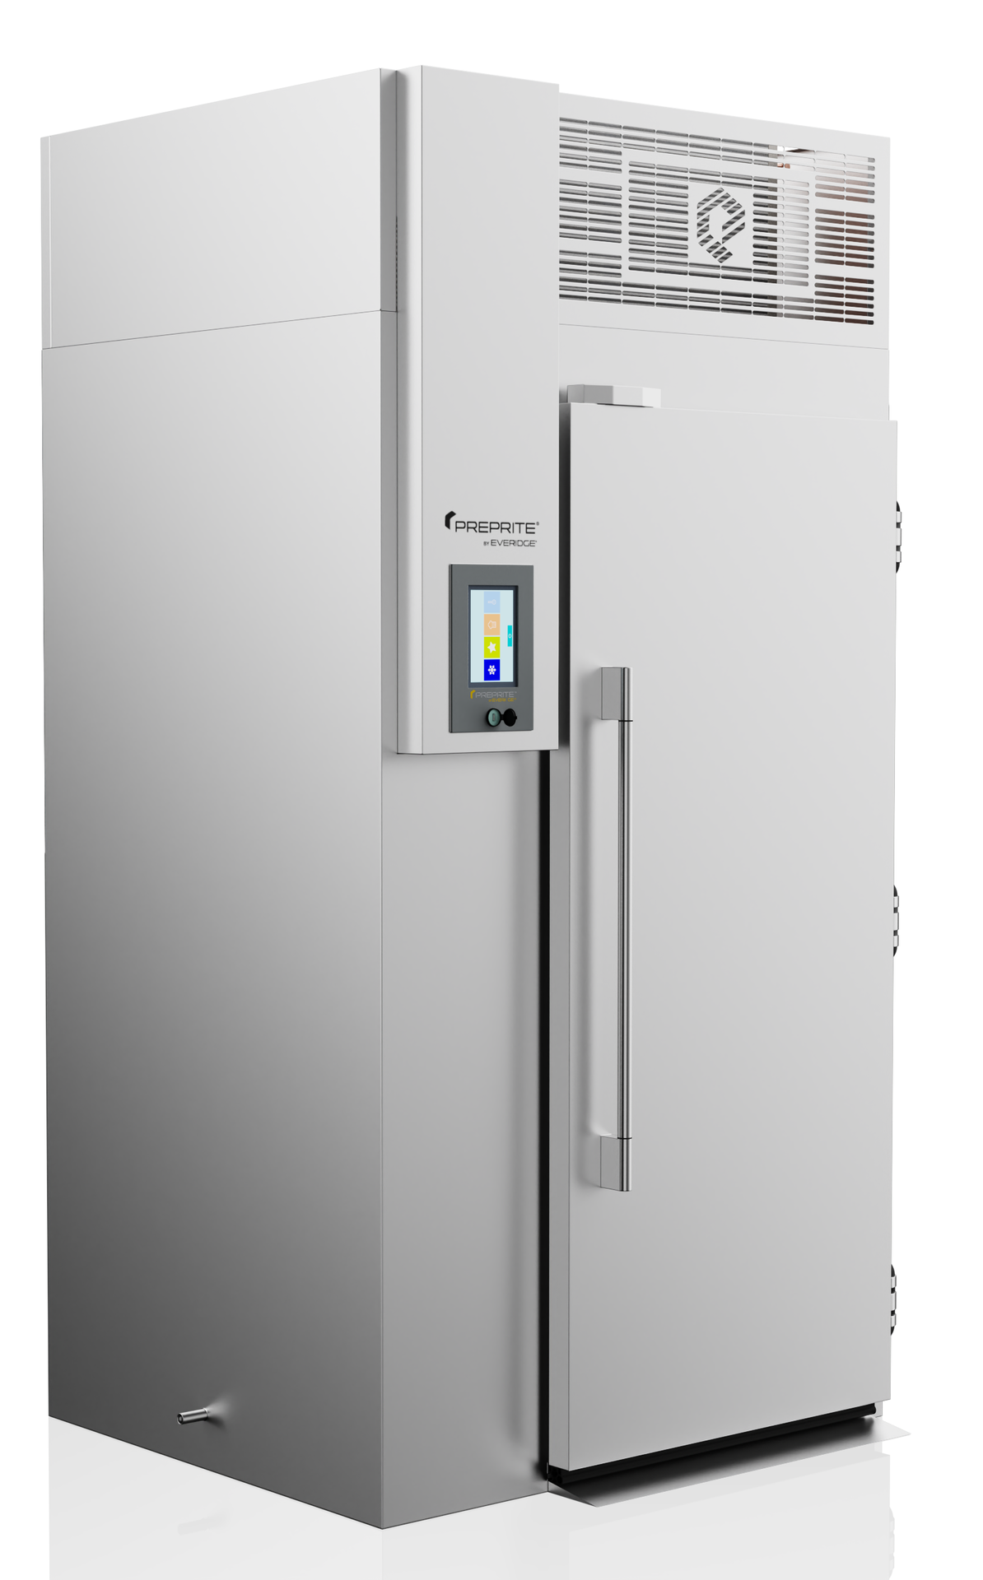
PBF20.1

Slide 6
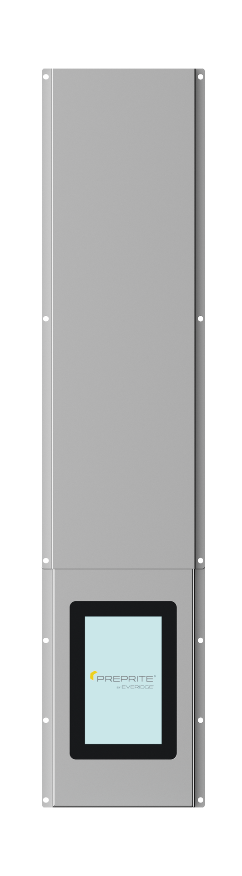
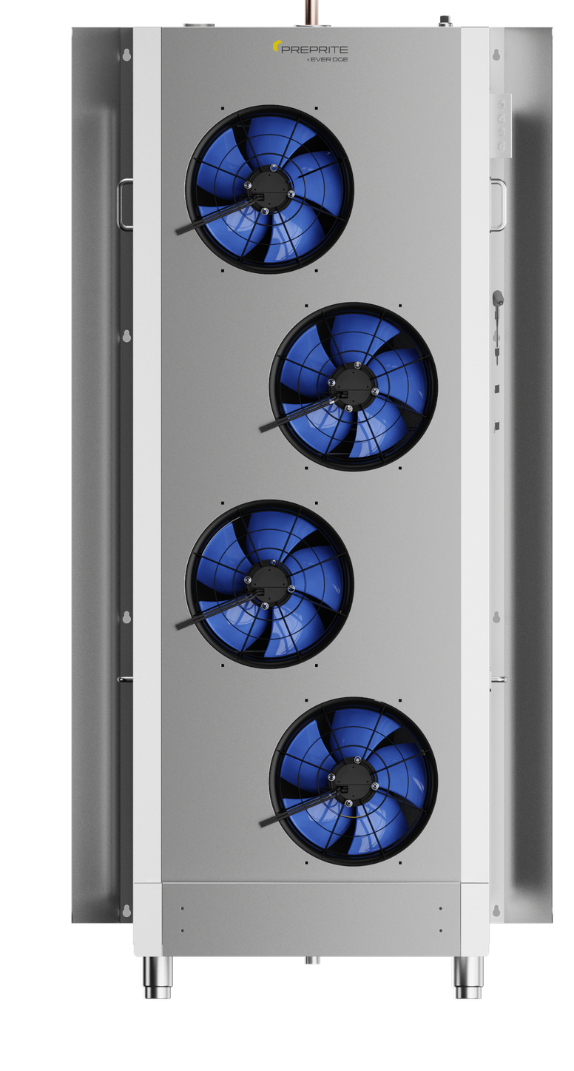
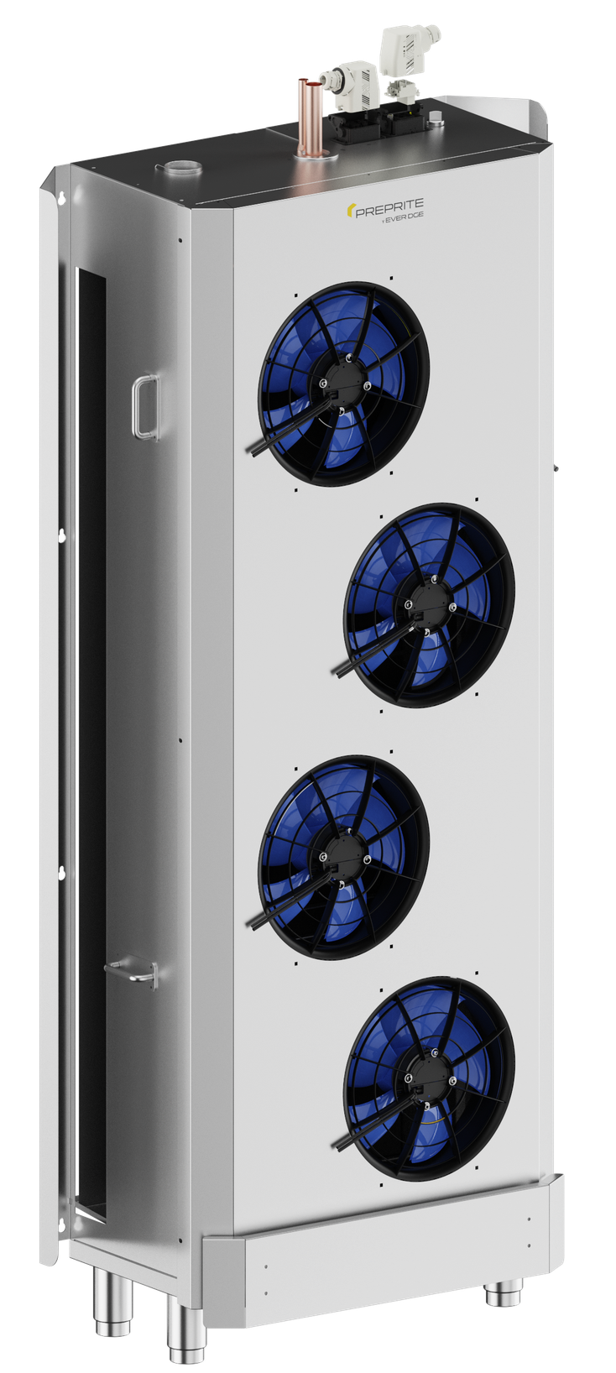

Modular Blast Chiller Current & Gen. 2
Simplicity of Installation & Better Chilling Outcomes
Pre-set connection fittings for simplistic installation
Lower fan energy consumption while providing better cooling capability
Multiple control board options
Better air redirect system to maximize cooling

Slide 7
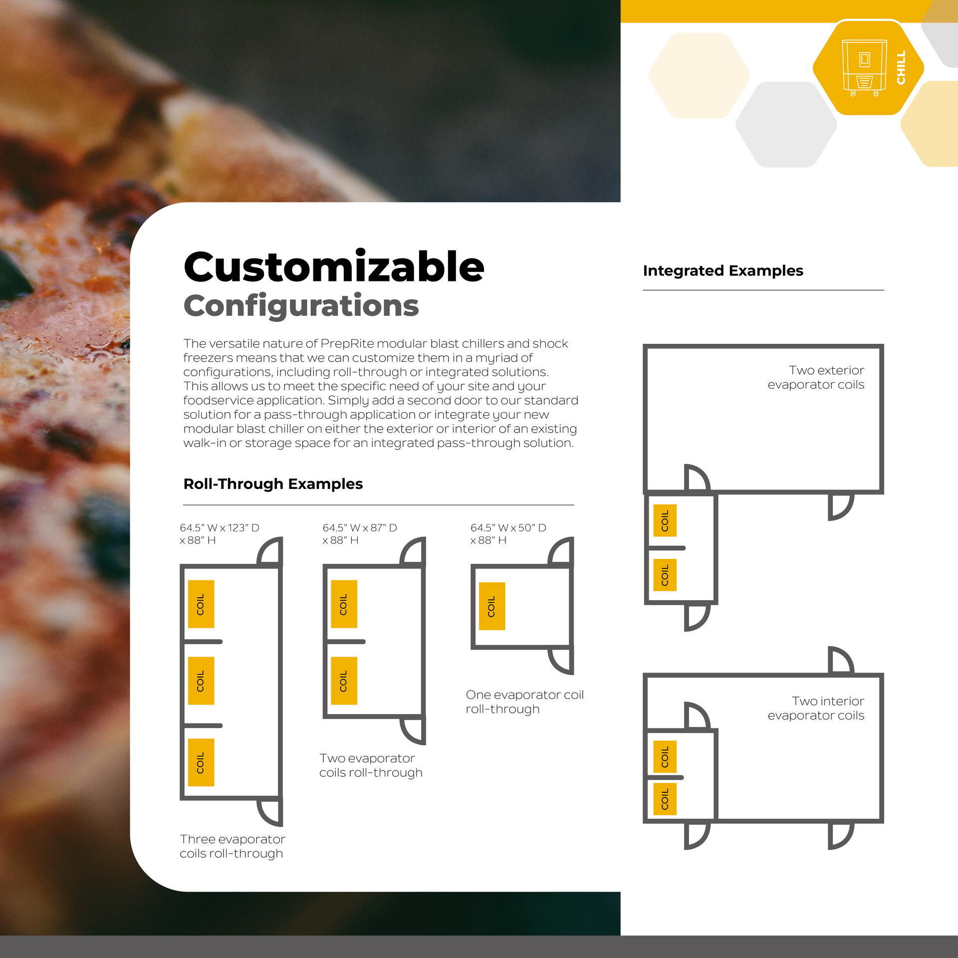
Current Modular Blast Chillers –
Customizable Configurations
Roll-through examples
Integrated examples

Slide 8
PBF1200 XL Design Drawing
XL Modular Blast Chillers
Standard doors are 40” wide to accommodate the largest Rational Carts
XL Spec Sheets with updated cabinet sizes

Slide 10
Pastry
Catering
Foodservice
Chocolate
Gastronomy
Cook-Chill
“The blast chiller was a lifesaver during the last few months! Without it, we would have lost so much product and not made it through.” – Lisa Mickey, Lead Chocolatier
Notes:
Moving on to our PrepRite by Everidge blast chillers! they turn cold storage into a tool for protecting flavor and streamlining production. Designed to be simple for staff to use, it helps kitchens preserve freshness, support food safety, and deliver consistent results — giving dealers a clear advantage in high‑volume and make‑ahead operations.

Slide 11
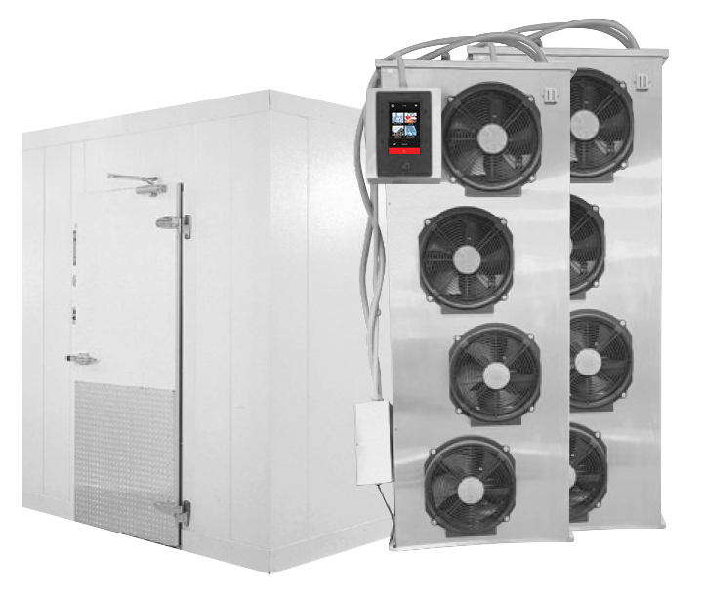
Specify for food safety, leverage for productivity!
An intuitive and complete family of blast chillers and shock freezers from the GREEN PBF4.0 R290 refrigerant undercounter unit to our fully customized modular units capable of chilling up to 1200-lbs in just 90 minutes!
R290
4.0
5.0
7.0
12.0
15.0
20.1
250 | 450 | 850 | 1200
Notes:
Models range from modular walk-ins to countertop, undercounter, and standalone models to meet the desired capacities of any kitchen.
“The important takeaway: there’s a right size for the job — and we can support sizing conversations.”
Everidge offers the Best value in blast Chillers with great performance and features at a great price.
Where Most Blast Chillers
Can chill food down from 160°F to 37°F, it Requires cooling hot food down to 160°F before you can start blast chilling
PrepRite’s PBF4.0, 5.0, 7.0, 12.0, 15.0, & 20.1 Blast Chillers
Can chill food down from 194F to 37F in 90 minutes
One less step for operators that also saves precious time
Universal pan slides can be used for sheet pans or hotel pans

Slide 12

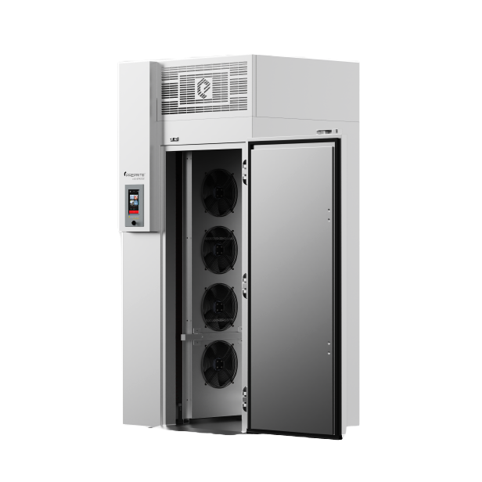


20.1 Blast Chiller
Maximizes space and efficiency to keep kitchens, even in tight footprints.
Designed for smoother workflows, faster access, and consistent performance.
Quick Start button on the home screen
Cloud base for HACCP retrieval
Customizable control
Each probe will alarm separately when it hits the set target
Alarm & info will be Green when the product is ready to remove
Notes:
“The 20.1 is our most popular model.
It offers full single-cart capacity, intuitive controls, cloud-based HACCP retrieval, and separate probe alarms — all designed with chefs in mind.”

Slide 13
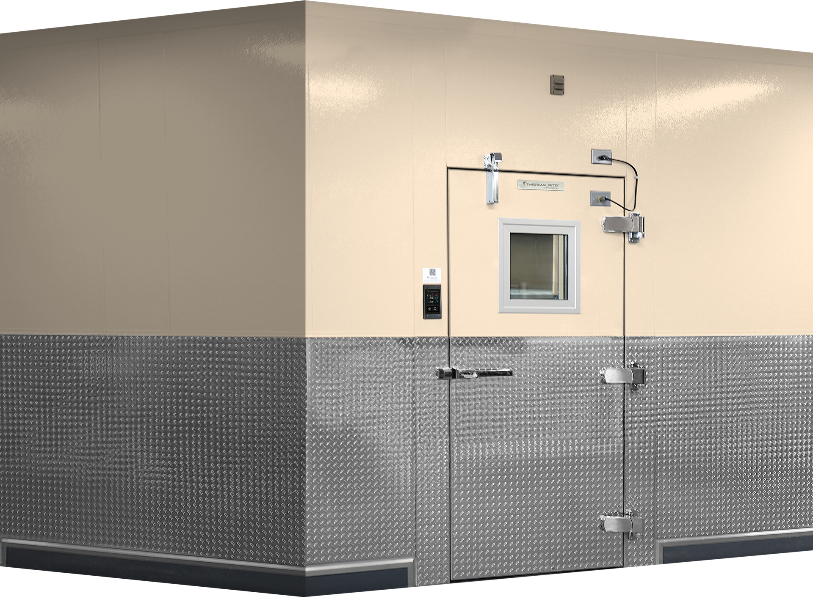
Simplicity of Installation & Better Chilling Outcomes
Notes:
PrepRite’s modular blast chiller systems are designed for larger operations that need higher capacity, flexibility in layout, and consistency across multiple projects.”
“The modular design allows us to scale chilling capacity to the operation — whether that’s adding evaporator sections, configuring airflow, or integrating into an existing space — without overcomplicating installation.”
“

Slide 14
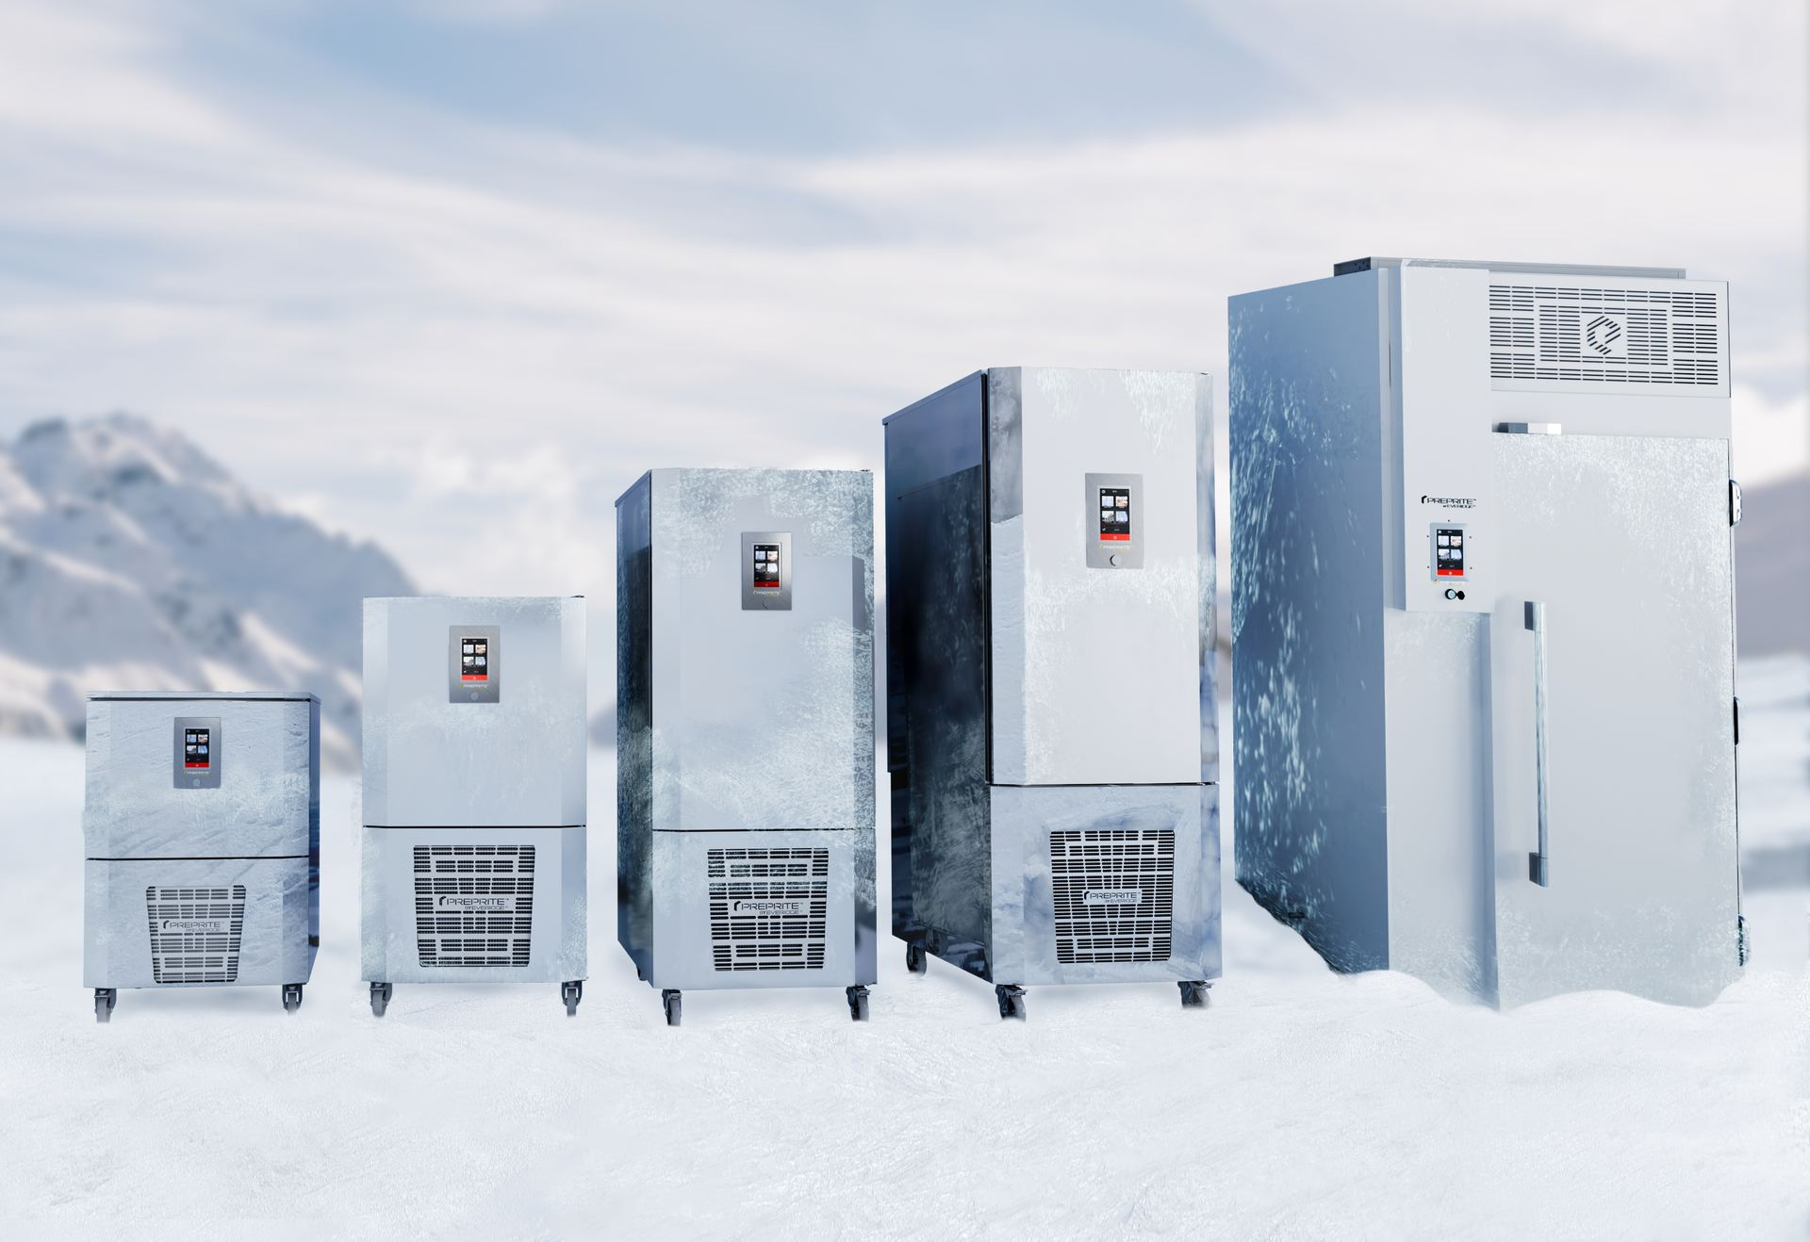
Our PBF 3.0, 5.0, 7.0, 12.0, 15.0, & 20.1 Blast Chillers
Can chill food down from 194°F to 37°F in 90 minutes
One less step for operators that also saves precious time
Universal pan slides for sheet pans or hotel pans
Notes:
Most Blast Chillers
Can chill food down from 160°F to 37°F in 90 minutes
Requires cooling hot food down to 160°F before blast chilling
Additional wire racks for hotel pan accommodation

Slide 15
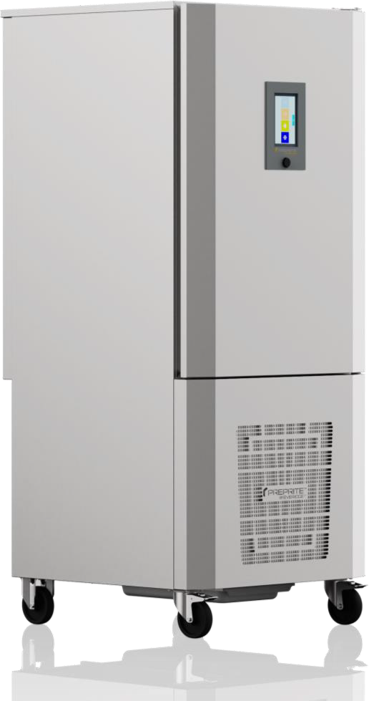



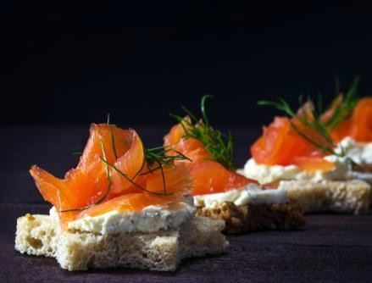
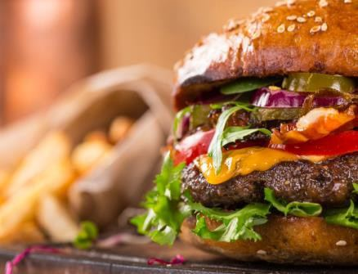
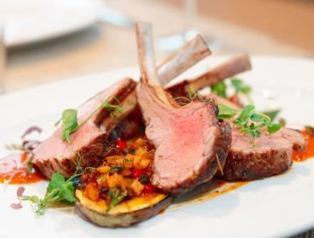
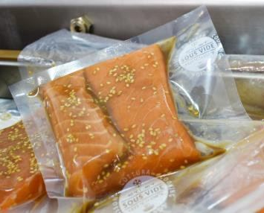
Blast Chillers/Shock Freezers
Specify for food safety, leverage for productivity!
Models range from modular walk-ins to countertop, undercounter, and standalone models to meet desired capacities
“The blast chiller was a lifesaver during the last few months! Without it, we would have lost so much product and not made it through.”
– Lisa Mickey
Lead Chocolatier
Ambient chill method for rapid temperature pull down
Pastry Chocolate Catering Foodservice Gastronomy Cook-Chill

Slide 16

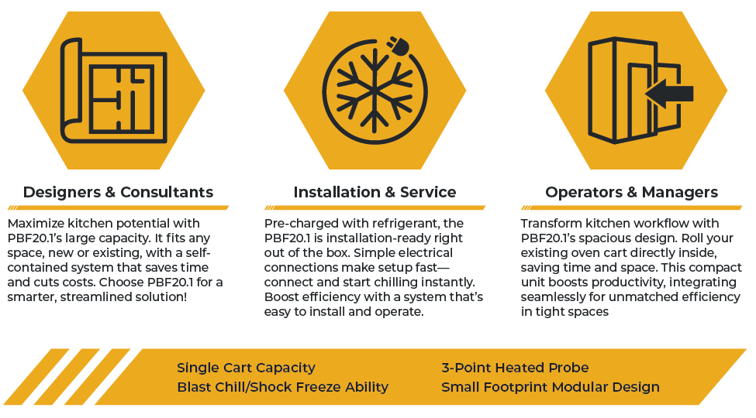
The Compact Powerhouse for Seamless Chilling
PBF20.1
Redefine efficiency, maximize space, and simplify installations!

Slide 17
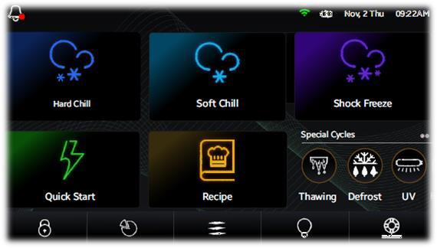
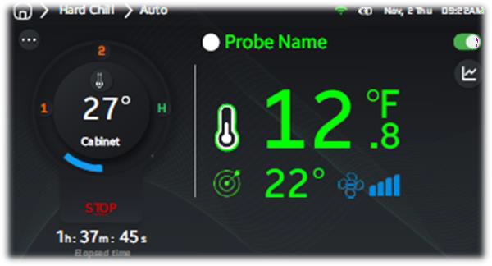
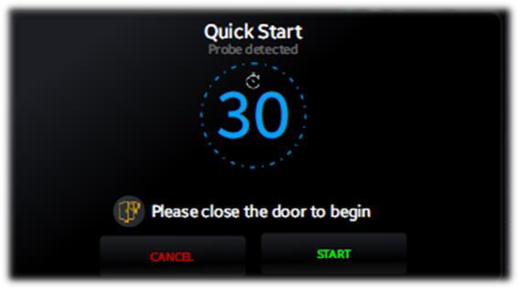
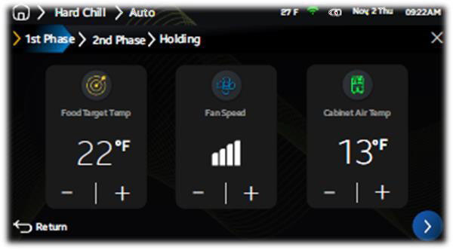

Next Generation Control System
Built for Chefs
The control board updates will remain simplistic for a chef to adjust to fit their needs when using a blast chiller
The home screen can be adjusted to remove options if needed
Quick Start button on the home screen
Cloud base for HACCEP retrieval
External Alarm & info will be Green when the product is ready to remove
When running multiple probes, each probe will alarm separately when it hits the set target
Food probes will be color coordinated & probe name will match the color

